Slide 1

MightyMover
CPE4800
Chris Turner, Hanson Chaney
Grant Burke, Cooper Newlin

Slide 2
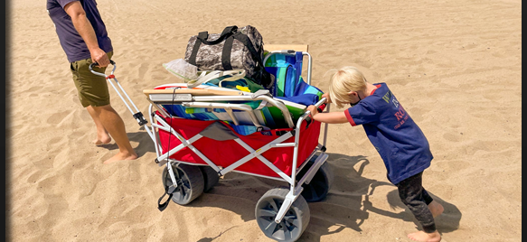
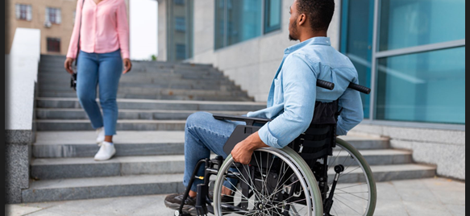
The Problem
Everyone has trouble carrying objects.
What solutions are there for the physically challenged?
Even wagons need to be pushed and pulled which causes strain on the body.

Slide 3
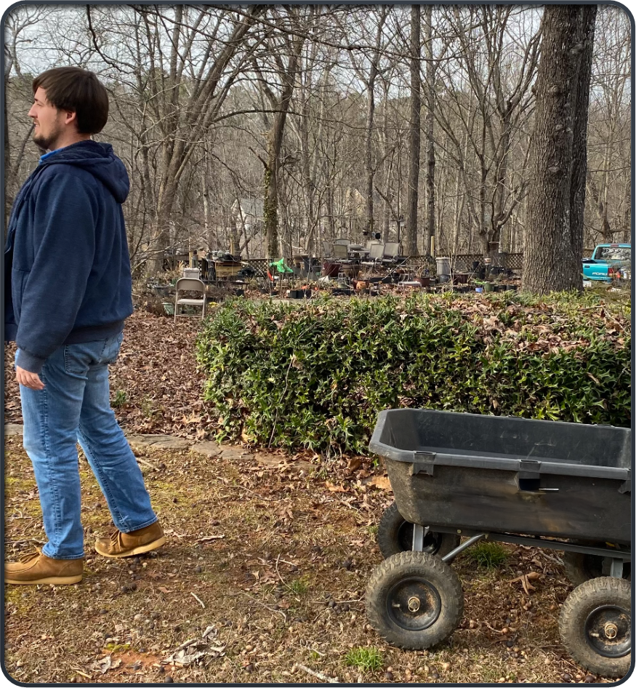
The Solution
Our solution is a product that will get the user's items to and from without interacting with the cart.

Slide 4
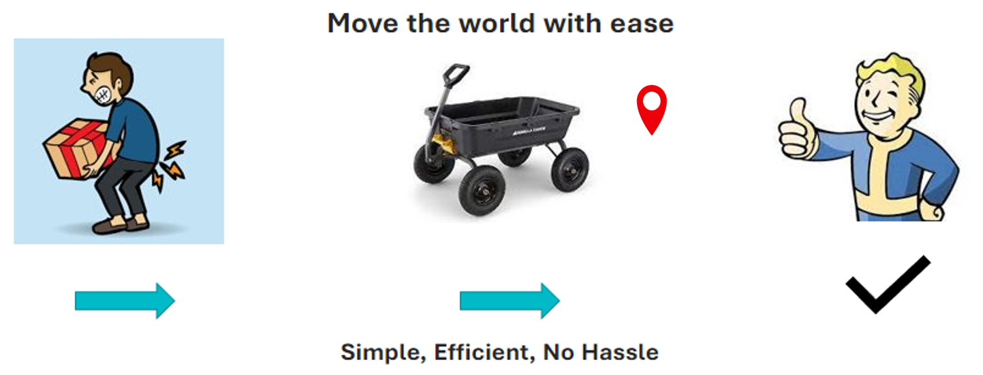
Value Proposition

Slide 5
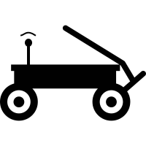
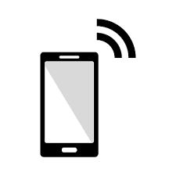
System Description
The MightyMover system is a two-component system. It includes the user’s phone and the mover.
The user’s phone will have an app compatible with the MightyMover. The user will send instructions and get feedback over a Bluetooth connection.
The Raspberry Pi will process the Bluetooth communication, object detection code, and PWM output (for the motors).
The MightyMover includes subsystems such as:
Phone-to-MightyMover Communications
MightyMover Motor Control System
LiDAR Sub-System
Software Hub Design and Battery Management.

Slide 6
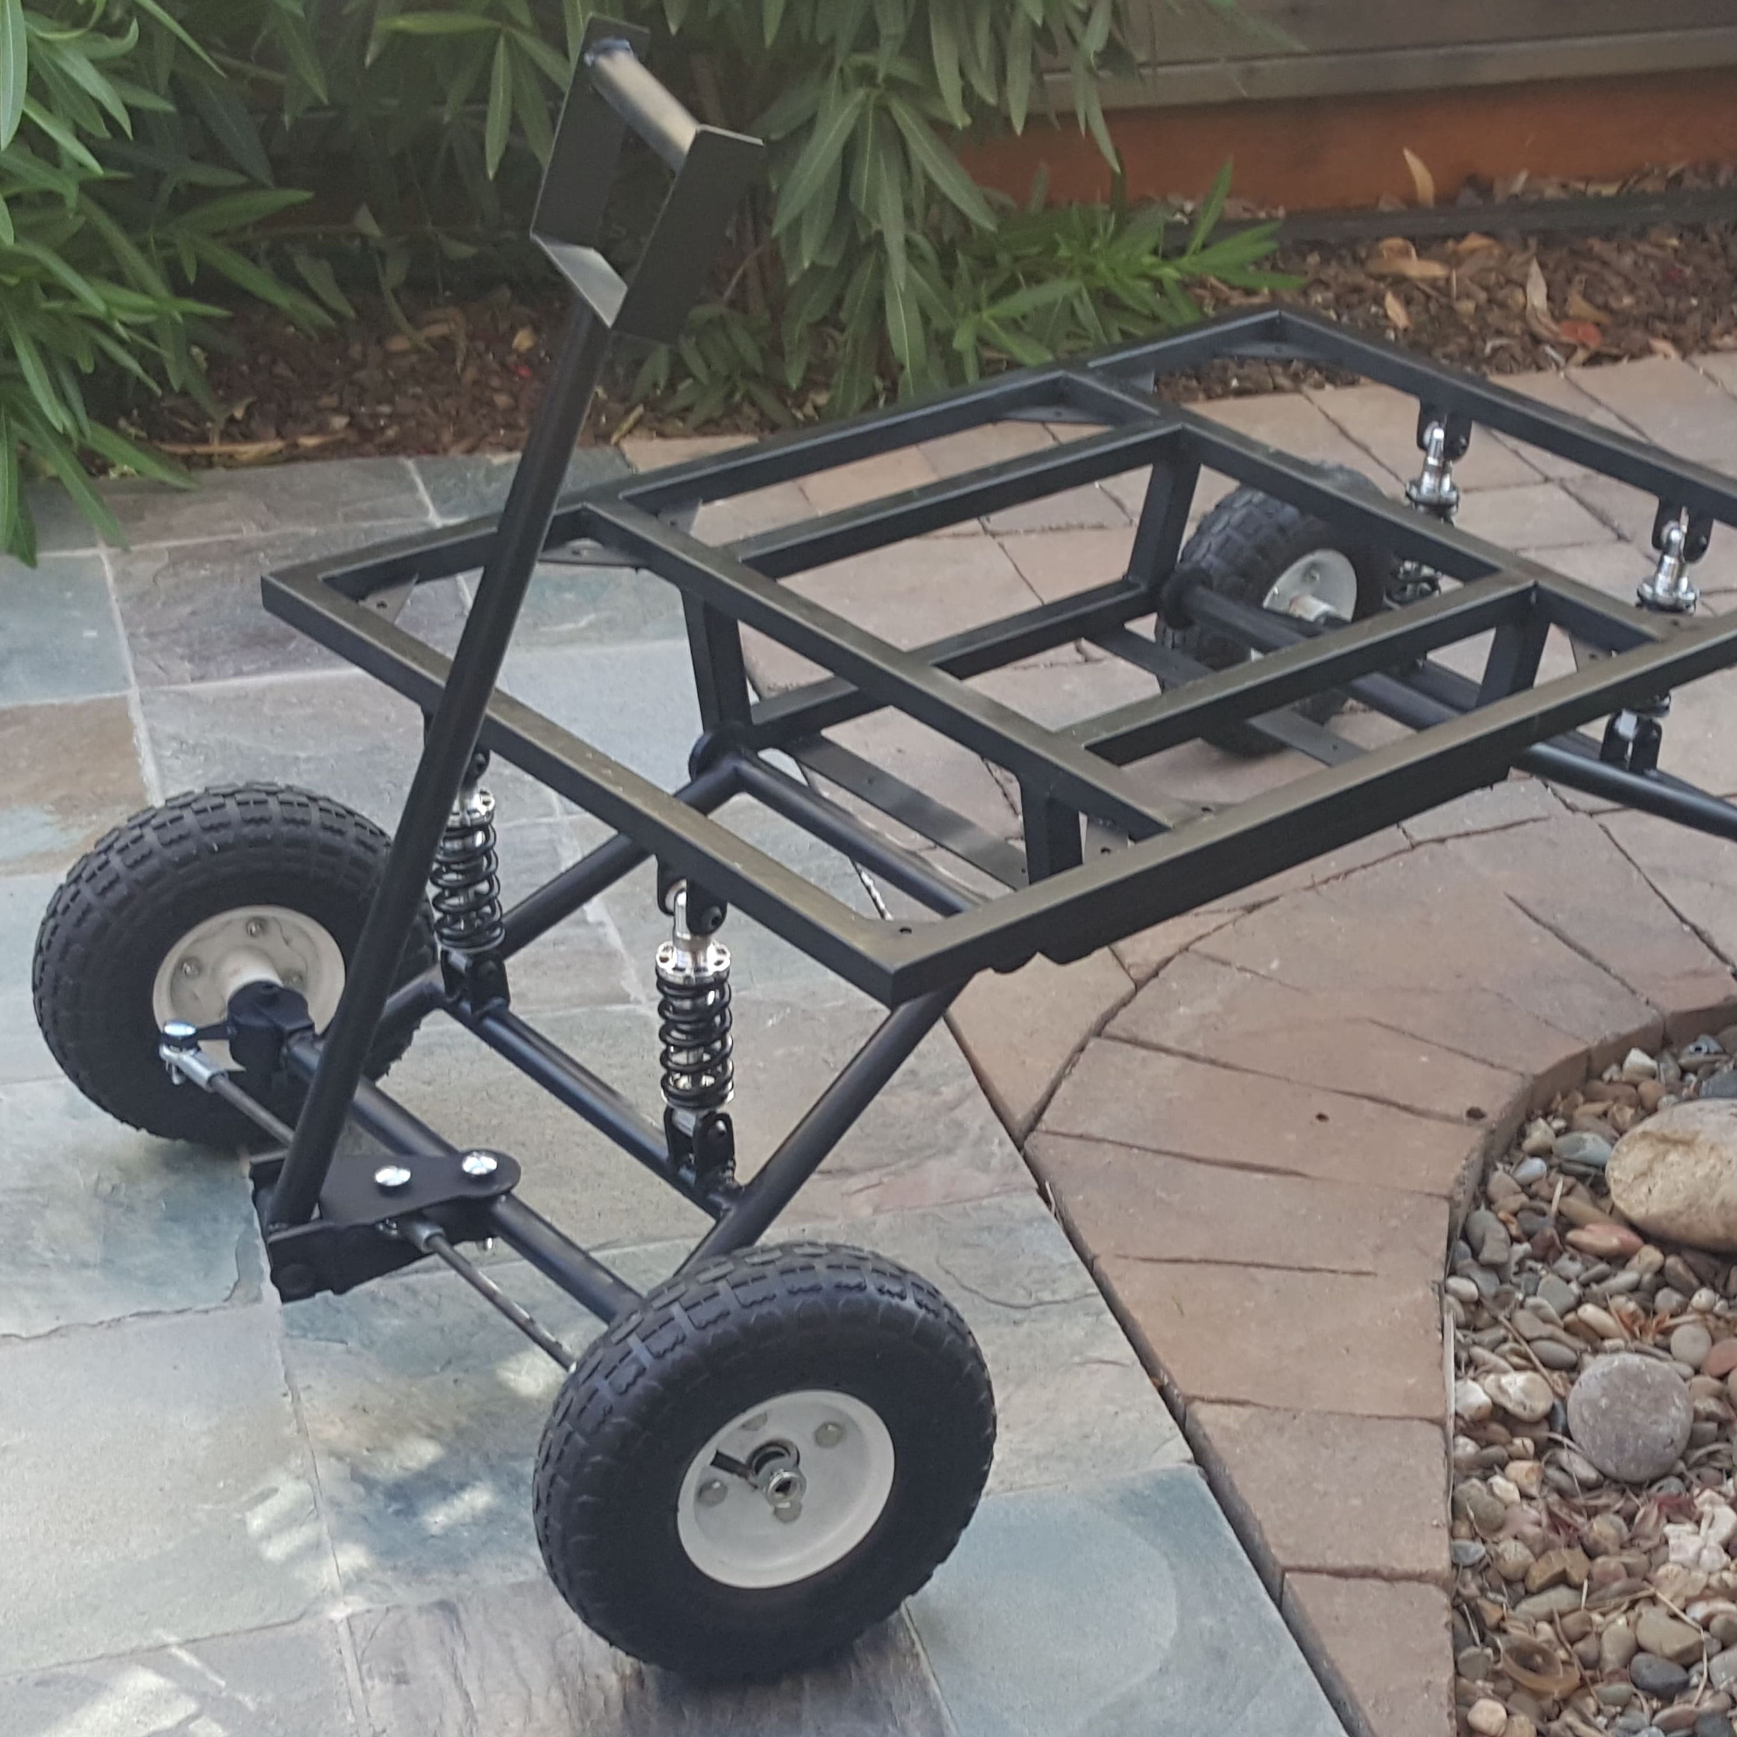
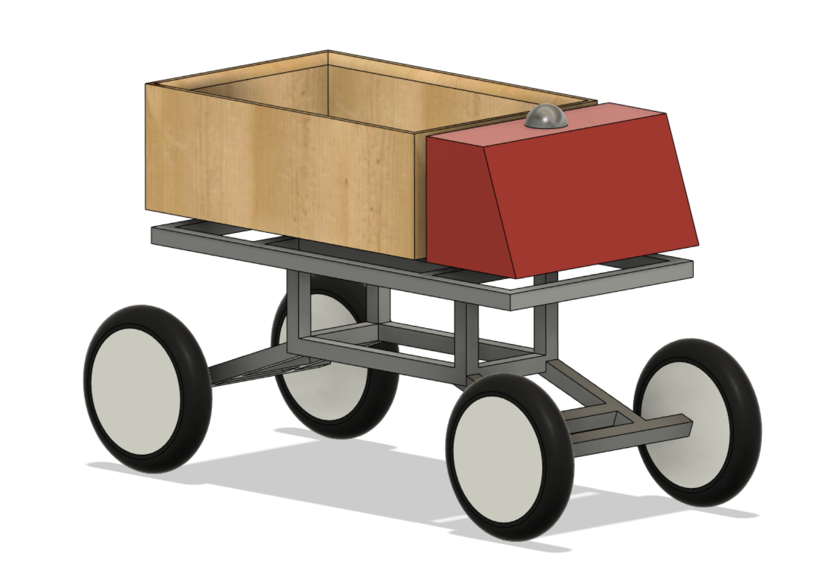
Mock-up/visual

Slide 7
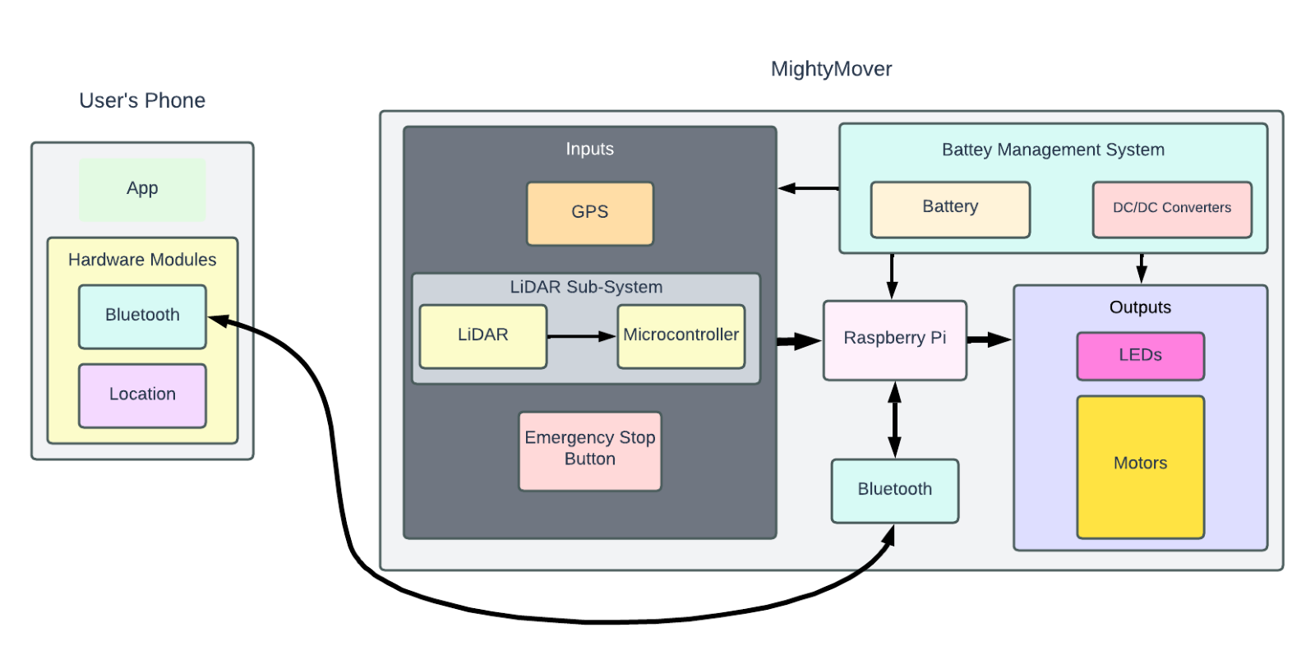
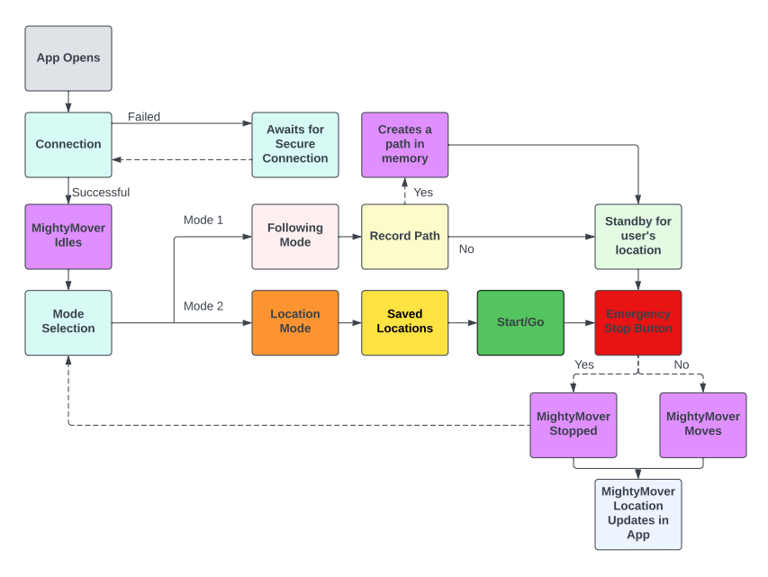
System Block Diagram and App Flow Block Diagram

Slide 8
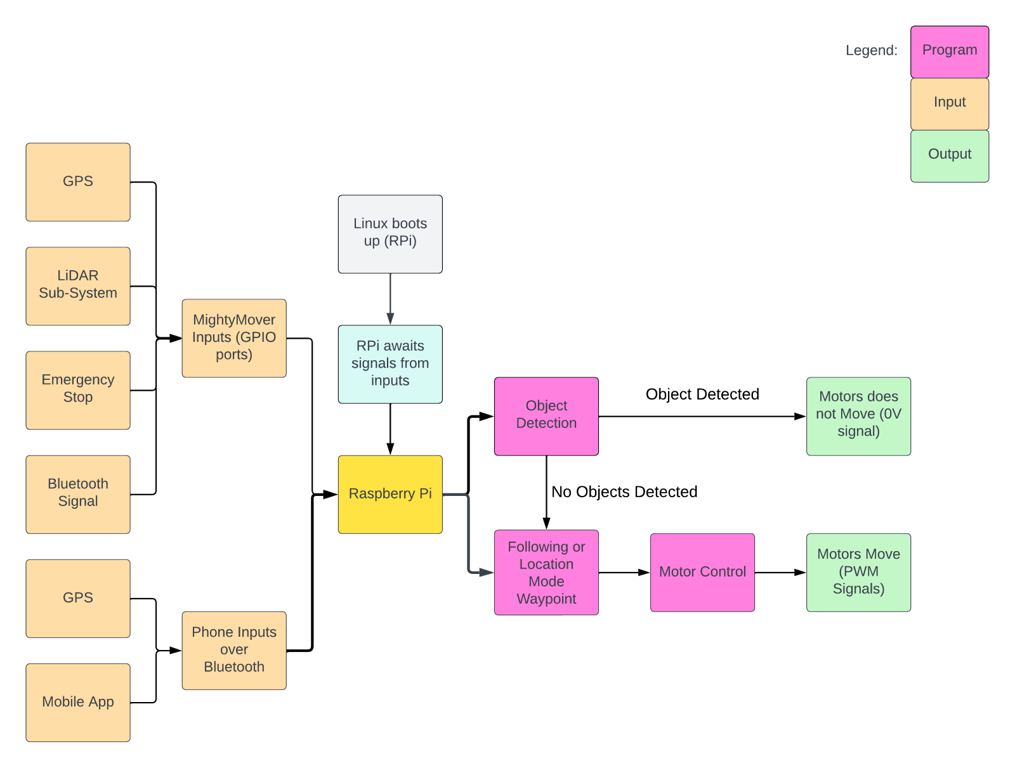
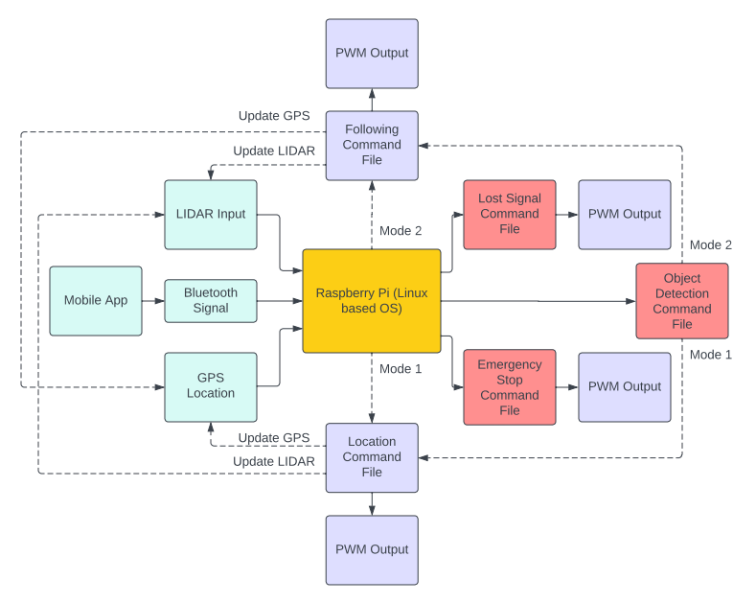
Object detection Block Diagram and Software Block Diagram

Slide 9
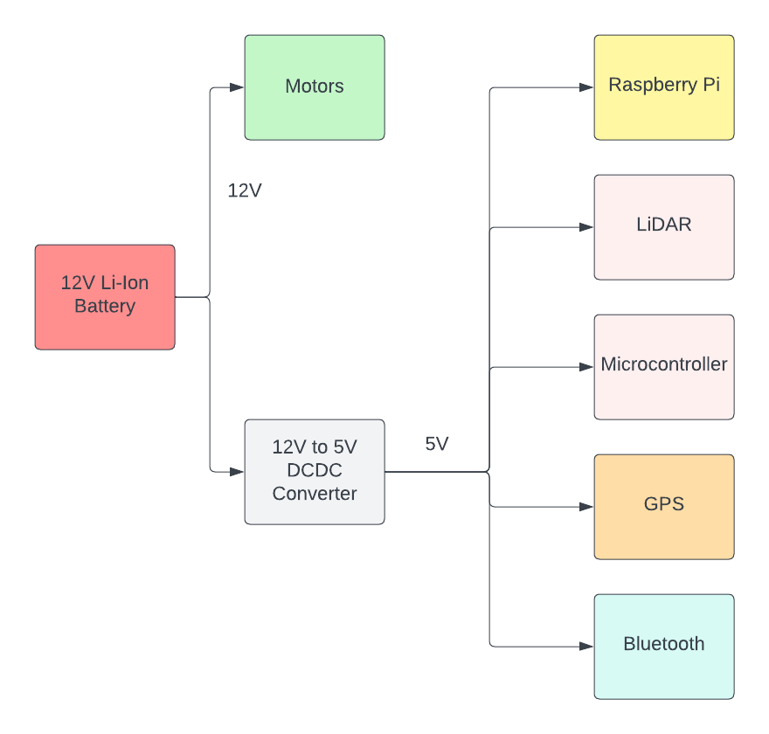
Battery Management Block Diagram

Slide 10
Key Product Requirements
ID-Name | MOVER-SYS-001: Phone to MightyMover | MOVER-SYS-002: MightyMover Motor Control System | MOVER-SYS-003: LiDAR Subsystem
Description | This sub system is the process of the phone and the MightyMover communicating. The user will have feedback from MightyMover showing the battery percentage, location monitoring, and the current mode of the Mover. The app will start with a mode selection which would be following or location mode. | The motors determine where the MightyMover moves. The motors will be controlled by a Raspberry Pi PWM GPIO port. The Raspberry Pi will make decisions based on the user’s phone location and all the sensors on the Mover. | The LiDAR system will include a microcontroller to process the LiDAR data to convert into serial communication for the Raspberry Pi. This system is very important because it will help determine object detection, help create a path in memory, and make sure we are following the user.
Key Components | Mobile App, Bluetooth Module, Raspberry Pi | Raspberry Pi, LiDAR sensor, GPS module, mobile app, Bluetooth Module. Motors, | LiDAR sensor, Raspberry Pi
Interfaces | Android OS, Linux OS | Linux OS, Speed Controller | Linux OS, Raspberry Pi GPIO
Requirements | PRD-SYS-001 – Must have Bluetooth 5.0 Connectivity. PRD-SYS-002 – Must Receive Bluetooth Signal up to 50 meters away from module. PRD-SYS-003 – Must transfer data at a speed of at least 2 Mbit/s. | PRD-SYS-004 – Motor must consume no more than 12V. PRD-SYS-005 – Motor must possess 30 Watts of horsepower. PRD-SYS-006 – Motor must be smaller than 2x2x3in. | PRD-SYS-010- The LiDAR sensor must be capable of sensing objects within 12 meters of the device. PRD-SYS-011- The LiDAR sensor must have a sample rate of 8000 Times. PRD-SYS-012- The LiDAR sensor must weigh no more than 1 pound.

Slide 11
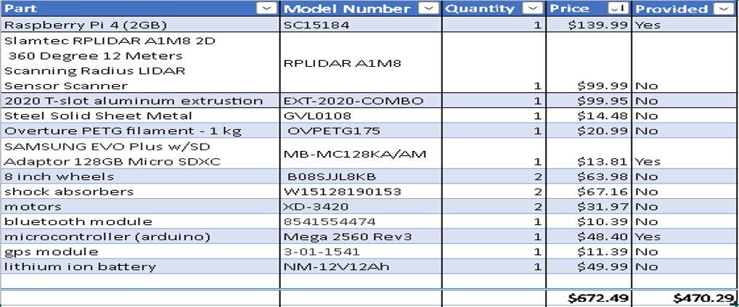
Bill of Materials

Slide 12
Proof of Concept - Auto-following
The auto following algorithm is our project’s unique feature and most of the hardware is built around this feature.
The final product will rely on GPS data from the user's phone continuously updating to the mover allowing for front servo and rear driver motors to react based off the user's position relative to the mover.
This will be accomplished by taking two coordinate points and comparing values. If one coordinate differs then transfer that information into a steering angle and PMW output to a driver motor.
The demonstration you see today is our proof-of-concept implementation using ultrasonic sensors instead of GPS coordinates.

Slide 13
Proof of Concept - Auto-following The major issue
You might be wondering why we opted for ultrasonic sensors rather than GPS data for our proof of concept.
Problem 1: GPS data was precise, but not accurate
Our GPS module was given ample time to update its location relative to the ten or more satellites it was connected to, however our latitude and longitude values did not change
Problem 2: Needing another GPS module/device to compare the mover and the user's location
For this to work, we would need either another GPS module, or better yet a smart phone to transmit highly accurate GPS coordinates via Wi-Fi to the mover.
Using the RPI to intercept cell phone GPS data deemed to be a task we did not have time and knowledge for within the time frame leading up to this presentation

Slide 14





Reflection
During this semester we learned to:
Navigate difficult objectives as a team
Assign roles to each member
Construct a physical prototype from an original idea
Budget time effectively
Follow the engineering design process
Create professional marketing and technical documents
Utilize faculty expertise
The current GPS limitations will be conquered over the summer
The time spent with Dr. Kihei and his GPS project has been humbling
We firmly grasp the work ahead and are committed to producing a high-quality product

Slide 15
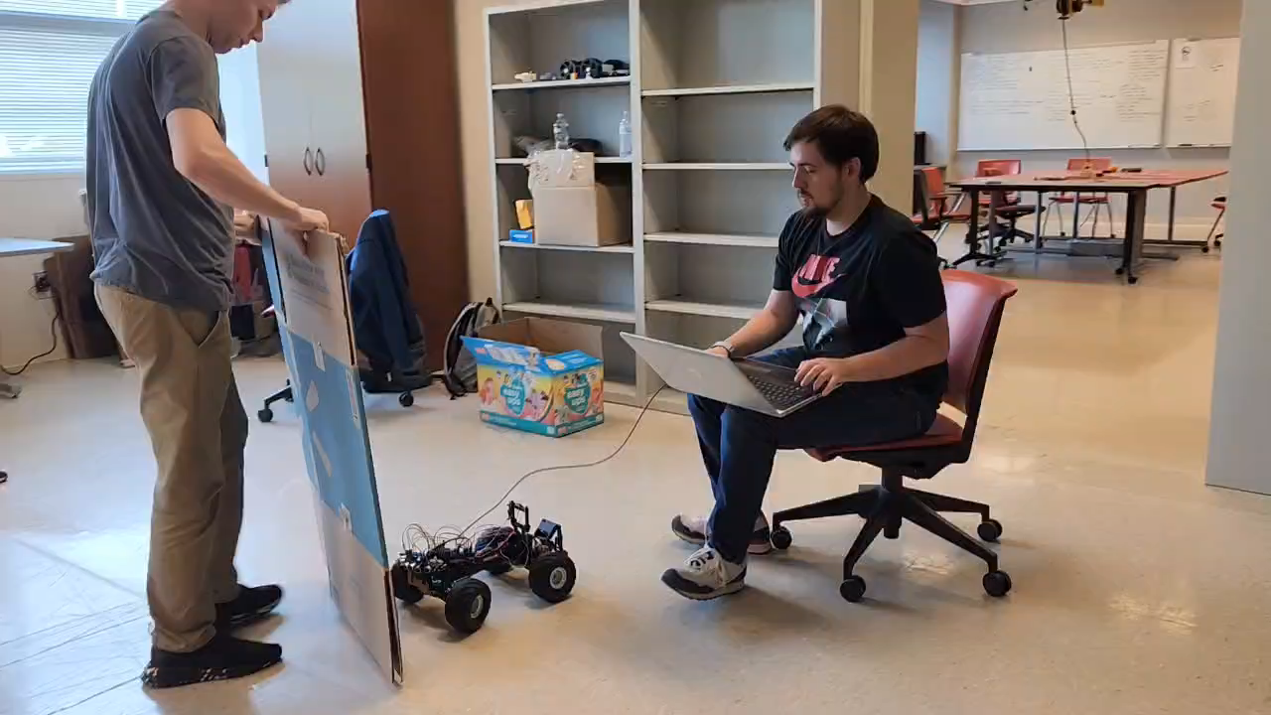
Demo Video

Slide 16


